Slide 1


Publisher Perspective
Becoming a Publisher in the Hobby Games Industry
Byron Collins
© 2015 Collins Epic Wargames LLC
Download This File: http://www.collinsepicwargames.com/Files/GTS/

Slide 2
Topics of Discussion
Part 1 - Setting up a Game Publishing Business
Define Areas of Focus
Business Plan
Business Structure and License
Fictitious Name (DBA)
Federal EIN
Sales & Use Tax
Bookkeeping and Finances
Timing your Industry Entry

Slide 3
Topics of Discussion (cont.)
Part 2 - Publishing - In General
Define your Roles and Stick to Them
Advertising & Promotion
Website Development, Updates, and Sub-Sites
Social Media
Getting started with Distribution
Sales – Direct and Indirect
Sales – Convention Tips
Fulfillment

Slide 4
Topics of Discussion (cont.)
Part 3 - Bringing Games to the Market
Choosing and Evaluating Game Designs
The Development Process
IP Protection
Print Run Size Considerations
Packaging Considerations
The Importance of Box Art
Commercial Printer/Supplier Selection
Setting MSRP
Funding a Print Run
Production and Kitting
Supporting your games
Building Relationships

Slide 5
Setting Up a Game Publishing Business
Game Design
Testing
Art
Define Areas of Focus
(not necessarily goals)
Areas of Focus:
Design
Artwork
Production
Playtesting
Crowd-funding
Business Aspects
Sales

Slide 6
Setting Up a Game Publishing Business
“When we set goals, we're taught to make them specific and measurable and time-bound. But it turns out that those characteristics are precisely the reasons goals can backfire. A specific, measurable, time-bound goal drives behavior that's narrowly focused and often leads to either cheating or [shortsightedness]. Yes, we often reach the goal, but at what cost?”
“To Avoid the negative side effects of goal-setting, try setting Areas of Focus instead.”
“A goal defines an outcome you want to achieve; an area of focus establishes activities you want to spend your time doing. A goal is a result; an area of focus is a path. A goal points to a future you intend to reach; an area of focus settles you into the present.”
– Peter Bregman HBR.org blog post 12/14/12

Slide 7
Setting Up a Game Publishing Business
The Business Plan
“A business plan is an essential roadmap for business success. This living document generally projects 3-5 years ahead and outlines the route a company intends to take to grow revenues.” -SBA.gov
Components of a Business Plan include: Executive Summary, Company Description, Market Analysis, Organization and Management, Service or Product Line, Marketing and Sales, Funding Request, Financial Projections, and Appendix (for supporting information).
Spend time (at least a month) to properly create your plan and use the resources and templates available through SBA.gov.

Slide 8
Setting Up a Game Publishing Business
Business Structure and Licenses
Separate your business and personal finances and protect yourself with an appropriate business structure such as a Limited Liability Company. Other structures include Sole Proprietorship, Cooperative, Corporation, Partnership, or S-Corporation.
No state or federal licenses are generally required for publishing games. However, virtually every business needs a local business license to operate. To be sure, check this state-specific list SBA.gov.
Seek advice from a lawyer if you have any questions on business structure or your legality to operate. Check with an accountant for tax implications prior to getting started, regardless of structure.

Slide 9
Setting Up a Game Publishing Business
Fictitious Name and Tax ID / Employer Identification Number
A Fictitious name or “Doing Business As” is typically a form filed with your local court that may feed into applying for a business license. DBA allows you to operate as a sole-proprietorship under a different name than your own.
Tax ID / Employer ID numbers are required based on the business structure you choose. For tax purposes, the IRS or state uses this number to identify your business. Forms vary and are located on the IRS.gov website.

Slide 10

Setting Up a Game Publishing Business
Collecting and Paying Sales and Use Tax
Sales Tax is a state-collected tax for sales made within the state the sale occurs. Your business must register to collect this tax as a minimum for sales within state.
For publishers, be aware that traveling to conventions out-of-state may require registering to collect sales taxes in that state as a “transient vendor.”
Some of the larger conventions may not allow you to exhibit unless you show both your Business License and Sales Tax Certificate for the state the show is in.

Slide 11

Setting Up a Game Publishing Business
Bookkeeping and Finances
Use accounting software such as Quickbooks, Moneyworks Express, or other software (even Excel) to track expenses, manage invoices, and monitor cash flow. It is especially important to be organized with respect to inventory, expenses, and sales when it is time to file tax returns.
  Tip 1: Keep all finances for your business separate from your personal finances and get in the habit of tracking everything your business spends and takes in.
  Tip 2: Hire the help of a bookkeeper or CPA part-time to help you manage this aspect of running your business. This can help you stay focused on design, production, testing, and sales.

Slide 12
Setting Up a Game Publishing Business
Timing your Industry Entry
Once all of the above is in place, it is time to begin execution of your Publishing Business Plan.
For publishers, it is highly recommended to have at least three products (separate games) designed, prototyped, and well-tested by people external to the company.
Once you have an idea of your Areas of Focus (how you’ll spend your time), your planned product line, your plan for marketing and advertising, your plan for funding, and all of the legal elements of your Publishing business are in place, it’s time to launch- which is when the real (and fun) work begins.

Slide 13
Publishing – In General
Create
Produce
Sell
Support
Define your Roles and Stick to Them
What are your roles as a Publisher?
Evaluate / Choose Games
Set and Manage Prices (MSRPs)
Manage Financial Risk
Manage Game Development and Testing
Manage Game Production
Protect Intellectual Property (IP)
Manage Inventory
Maintain a Web Presence
Establish and Maintain Effective Communications
Market, Advertise, and Promote Games
Sales and Shipping / Logistics
Support Gamers, Retailers, and Distributors after Sales

Slide 14
Publishing – In General
Advertising and Promotion
The greatest challenge- getting the word out about your games. This is particularly difficult if you are not established and requires time, money, and dedication.
Free avenues to do this require a lot of work - game or company website, ON-TOPIC forum posts on general gaming sites (BGG, for example), press releases through gaming news sites, are all useful but require time to be consistent and effective.
Paid banner ads on gaming-related sites or ads in printed magazines, e-zines, etc., can also be helpful, but ask the hosts for metrics before and after your ad campaign.
Form a budget for advertising up front and do not exceed it. Only purchase ad space that you can afford.

Slide 15
Publishing – In General
Advertising and Promotion – Cont.
Consider attending conventions such as Gen Con, Historicon, Origins, WBC, GTS, etc., and smaller regional shows as an exhibitor (only if selling a product) or as a demonstrator (cheaper, for pre-sales promotions). In-person demos are a great way to build a good customer base.
Word of mouth and in-person promotions such as at a local game shop or trade show are great for making contacts and for getting feedback. The contacts you make may be future customers, future play testers, or future retailers of your game.
Paid ads through distributors and distributor publications are another avenue to consider, but these can be expensive. See if the distributor allows ads exchanged for product credit.
Consider Social Media advertising.

Slide 16
Publishing – In General
Advertising and Promotion – Cont.
Establish a Facebook Page for your company. It’s essential and absolutely free to do (unless you buy their ads).
Establish a Twitter account for your company and use it for quick updates, to stream your newsletter to the public, and to keep up with other publishers and gamers.
Establish a newsletter that automatically manages subscriptions and complies with the CAN-SPAM act. Ask people at conventions and online to sign up, and use it as a detailed news source, occasionally providing special incentives to subscribers.
If you will provide video tutorials, establish a youtube channel to centrally host them. Embed them into your website, don’t host them.

Slide 17
Publishing – In General
Website Development, Updates, and Sub-Sites
Your Company website must be professional-looking, functional, informative, and offer content to gamers who have bought or will buy your products. Content should include game/rules updates, extra downloads, artwork and previews, news, information, tutorials, review links, contact information and forms, newsletter signup forms, and links to game information pages on other sites like BGG as applicable.
You can save a lot of money by designing and managing your own websites- but this takes a lot of time. If you DIY, consider and select a good host first such as InMotion Hosting. Look for features like unlimited bandwidth, unlimited storage, PHP support, and multiple sub-domains that you can add.

Slide 18
Publishing – In General
Website Development, Updates, and Sub-Sites
Monitor website statistics but don’t become obsessed with them. Occasionally look at statistics to help you understand:
  Where traffic is coming from (who is linking to your site and what advertisements are working)
  How much time people spend on your site or particular pages
  What adjustments are needed to your site design.
Don’t pay for website analytics or Search Engine Listing or Optimization services. Google, Yahoo, and other search engines handle much of this for you. DO ensure you include good META tags, titles, and keywords for each webpage.
You have about 10 seconds to grab the interest of anyone viewing your site.

Slide 19
Publishing – In General
Website Development, Updates, and Sub-Sites
Consider creating sub-sites for specific games. For example, have a main company website and separate sites for game lines. See www.collinsepicwargames.com vs. www.polyversal-game.com.
If you manage a web store for direct sales, consider using credit card acceptance methods that do not require you to pay monthly for a Merchant Account such as Square.
For all web stores and handling credit cards in general, you must strive to be PCI compliant (though in reality this is extremely difficult to actually achieve). For information on PCI compliance, see https://www.pcisecuritystandards.org/.
Ensure all of your web content is regularly-updated. When an update goes ‘live’, be sure to let your customers know.

Slide 20
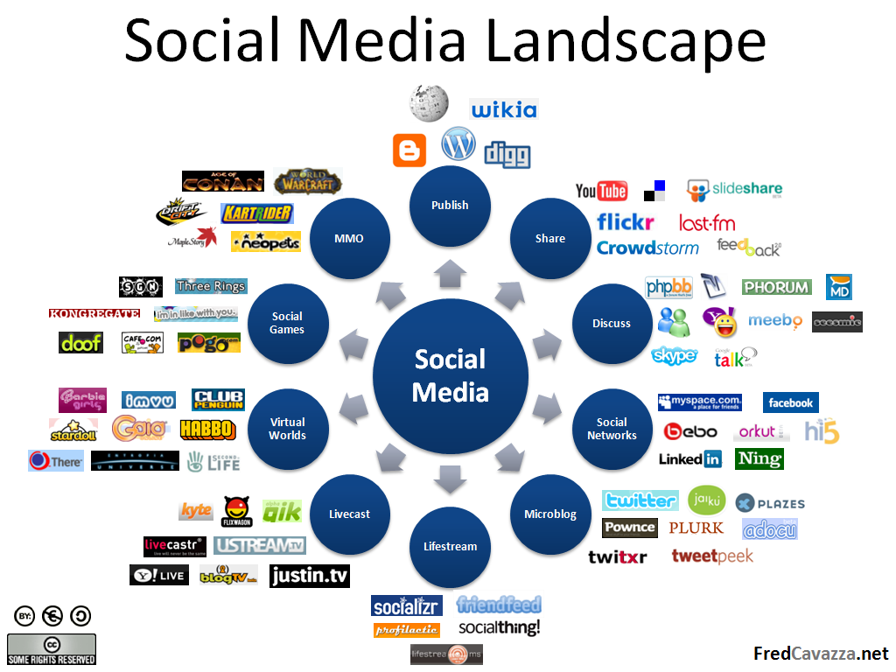
Publishing – In General

Slide 21
Publishing – In General
Social Media
Facebook and Twitter offer a means to easily interact with customers and other businesses. Get comfortable with Facebook. Create a business page and post content regularly.
Create or link to content that is interactive and engaging- this is NOT the place for another news feed. Many of your Facebook fans will already be receiving your newsletters- so don’t repeat everything.
Be sure to respond to messages, comments, questions, and content that others post. Try tools like socialmention.com to real-time search keywords about your brand or company.
Have your page “Like” other business pages. As you interact on their news feeds, be sure to post any comments “as your page”. Others may see your comment and click on your page’s name- you may gain fans this way from similar pages.

Slide 22
Publishing – In General
Social Media – Cont.
On Facebook, not all of your posts will be seen by all of your fans. Only a percentage of your posts will get through to the news feeds of users who like your page.
For posts that link to a sale, special announcement, Kickstarter launch, or other very important item, consider paying to “promote” that post. It costs approximately $5 per promotion and better ensures visibility of that post.
Content such as artwork previews, questions for your fans, and fun or interesting items generate more ‘likes’ and interaction.
Encourage fans to “share” content you think is particularly important. Shared posts show up on the pages of your fan’s friends.

Slide 23
Publishing – In General
Getting Started with Distribution
Have a product (or products) in near-final form and ready to show to a distributor before approaching them. Be prepared to answer questions like “What is the case quantity?, What are your terms?, What is MSRP? How will you handle damaged/missing product?”
When setting MSRP, ensure you can meet typical distributor terms- which include a 55-60% off MSRP discount and free shipping of cases to distributor warehouses or freight forwarders in the USA.
Ensure you read and fully understand any distributor agreement(s) / contracts you are asked to sign. Do not be afraid to ask questions.
Distribution is the key to getting your games in stores worldwide.
For a large retailer managing a lot of inventory, placing a single order with a distributor for everything they need is much easier than placing multiple orders with individual publishers.

Slide 24
Publishing – In General
Sales – Direct and Indirect
Indirect Sales (through distribution) help increase your reach into game stores and other countries. Some publishers focus exclusively on indirect sales.
Direct Sales at conventions or online in your own web store (or through Amazon, E-Bay, etc.) are only limited by the reach you build over time. You can make more profit by directly selling to customers, but there is also more work and expense involved. Direct sales are the best way to connect with and meet your customer base.
Recommendation: A combination of both methods as your time and budget allows.

Slide 25
Publishing – In General
Sales – Convention Tips
Conventions are excellent opportunities to meet existing customers and make new ones, increasing your audience base and exposure, while making sales of your games.
Tip 1: If you only attend one convention each year, in one region, you limit yourself to the attendees that show up there typically every year. Attend various conventions that your target audience attends- in as many different regions as you can.
Tip 2: Take time during and after convention hall hours to give demos of your games. Demos are the best way to make sales.
Tip 3: If you are not much of a salesman, take the time to develop this skill before jumping in. Books such as Zig Ziglar’s Secrets of Closing the Sale can be extremely helpful.

Slide 26
Publishing – In General
Sales – Convention Tips
Tip 4: Do not sit idle at your booth. You are paying to exhibit your games. Show passion about them and do not ignore customers. Your games will not sell themselves. You or who you hire must be active and engaging.
Tip 5: Do not overspend on convention space or props to “look big”. Start small and ask about “entrepreneur rates.”
Tip 6: Have a brochure of products, business cards, flyers, or other literature to hand out about your games. Use a site like Vistaprint.com to help with creation of these handouts. Ask those you engage with to sign up for your newsletter if they are interested in your products.
Tip 7: Beware of hidden costs such as booth rental furniture, parking fees, internet or phone service, power connections, etc.

Slide 27
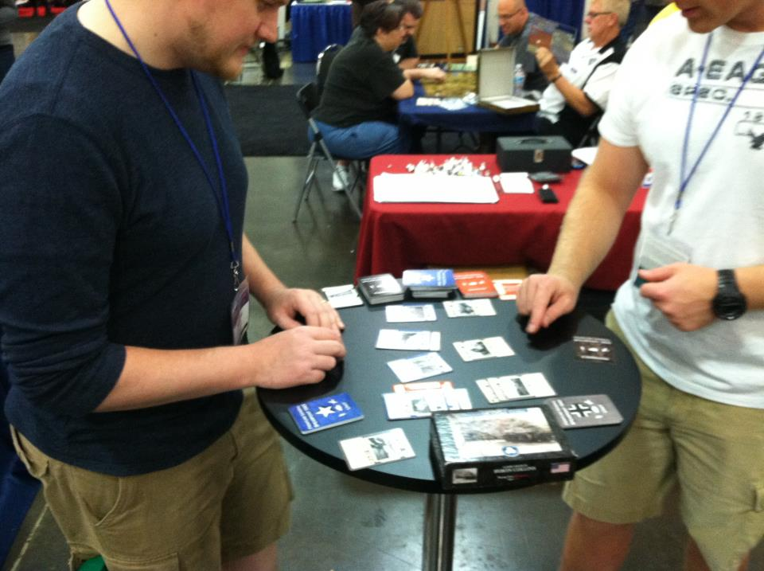

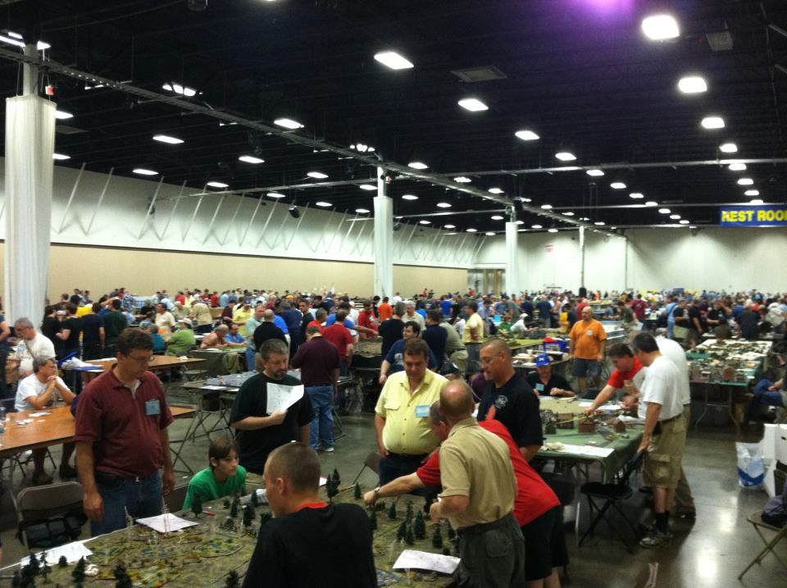
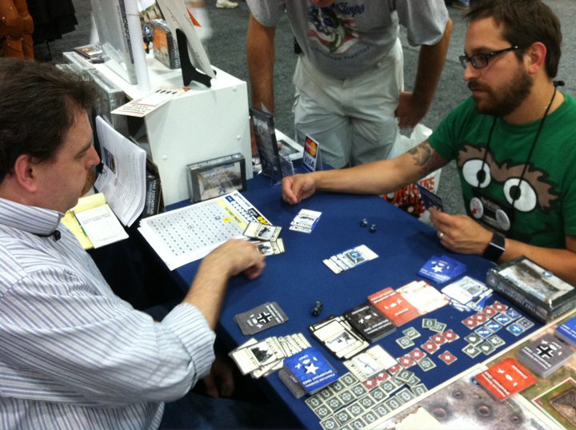

Slide 28
Publishing – In General
Sales – Fulfillment
Fulfillment is all about providing product to your direct or indirect customers in a timely manner after a sale is made.
Fulfillment can be extremely time-consuming as a DIY effort, yet rewarding.
Some publishers choose to use fulfillment services to ship their products to distributors or direct to customers, but beware that services like this can further cut into profits.
If you choose to do your own fulfillment, which is recommended at first, consider a printable-postage service program such as Endicia.
DIY fulfillment can take up a lot of space in your home or garage. Consider climate-controlled warehouse space at a local mini-storage business as an alternative to filling up your house with product.

Slide 29
Bringing Games to the Market
Choosing and Evaluating Game Designs
What is your company’s Area of Focus with respect to the games you want to publish? Are they miniatures games? Family Games? Wargames? Role-Playing Games? Euros? What is your brand or line?
Determine the above before accepting game submissions or commissioning designs – and ensure that the games you publish match that Area of Focus.
Traditionally, a Game Designer will submit their final, hopefully well-tested prototype to the publisher who will accept it, come to terms with the designer, and take the game further, or reject the submission and not pursue that design for whatever reason.
  Tip 1: Accept submissions of completed game designs that have been well-playtested. You will know whether or not this is true as you begin your evaluation.

Slide 30
Bringing Games to the Market
Choosing and Evaluating Game Designs – Cont.
  Tip 2: Evaluating a game submission takes time and must include consideration of the following:
    Playtest the game – is it fun? Does it work?
    What will it take to print/manufacture the game?
    What IP protection will be required?
    How hard will the game be to support?
    Is there a series or expansion potential?
    Has it already “been done”?
    What artwork is required?
    Does this game fit your “line”?
    Does this game violate the protected IP of another company or person?

Slide 31
Bringing Games to the Market
Choosing and Evaluating Game Designs – Cont.
  Tip 3: Be timely, outline expectations with the designer prior to evaluating the game, and provide feedback regardless of the decision to publish or not to publish.
  Tip 4: The choice to publish a game must be one that financially benefits everyone involved with that game- the publisher, distributors, retailers, printers, designers, artists, etc.- and benefits gamers by providing great gaming value / entertainment for their money.
If a positive decision is made, protect yourself and your designer(s) / artist(s) with a formal contract that outlines roles, expectations, monetary compensation, and any restrictions or limitations.

Slide 32
Bringing Games to the Market
Prototype
Test
Design Mods
Test
Theme Mods
Rules / Editing
Test
Artwork
Final Game
The Development Process
Development may be done externally or internally and may be iterative.

Slide 33
Bringing Games to the Market
IP Protection
Seek a lawyer’s advice for any questions about IP protection, licensing IP of others, or infringement concerns.
Two copies of each final published game should be submitted to the Library of Congress, along with $35, to secure a registered copyright and officially establish the date of publication (USA).
For a good discussion of IP as it relates to game design and publishing, read this pinned thread on BGG.

Slide 34
Bringing Games to the Market
Print Run Size Considerations
How many copies of a new release should you print? 100? 500? 5000? Crowd-funding campaign results, market size, distribution network, space available for inventory, cost per unit, budget, and estimated demand can all help determine this quantity.
  Tip 1: Request printer / supplier quotes in multiple quantities so you can understand how the “economy of scale” works in your favor with various printers.
  Tip 2: Do not over-print your first game, especially if you do not have agreements with distributors already in place, if you are specifying a high MSRP, or the demand for similar games is relatively low.
  Tip 3: Do not assume the entire print run will sell out within a year. Have a plan and place to store your unsold inventory.
  Tip 4: Consider a “Print on Demand” printer such as SuperiorPOD to reduce inventory. Note that this generally increases cost per unit.

Slide 35
Bringing Games to the Market
Packaging Considerations
Every printed game needs a box. Consider the following tips:
  Tip 1: Ensure all contents (in final printed form) – will actually fit! If any Kickstarter “Stretch Goals” will add components, make sure you have room for them in the box.
  Tip 2: Design the box’s outer extents to fit within one of the USPS “flat rate box” sizes – Small, Medium, or Large. This can help you predict shipping costs for direct orders and may be the difference between a sale or no sale- especially for international customers.
  Tip 3: Look at other game boxes to see what information is included on them. As a minimum for games, consider adding a UPC code, number of players, time to play, difficulty level, recommended age, your MFG part number, graphics showing the actual game in play, CE mark, country of origin, etc.

Slide 36
Bringing Games to the Market
The Importance of Box Art
Box art is the first thing a customer will see in a store, online, or otherwise. The art can be a huge turn-on or turn-off for gamers, retailers, and distributors. If your game were to tell a story, you should visually summarize that story with the box art.
  Tip 1: Spend money on this and commission something unique with a talented artist. It is obvious when a publisher skimps on artwork- you don’t want that feeling to be the first impression of your game.
  Tip 2: Ensure the artwork is actually relevant to the game.
  Tip 3: Search through box art used for similar games and don’t come too close to anything already out there. Don’t create brand confusion.
  Tip 4: For game series titles, ensure common elements or common design are prevalent in each game of the series.
  Tip 5: Browse this Geeklist for some inspiration!

Slide 37



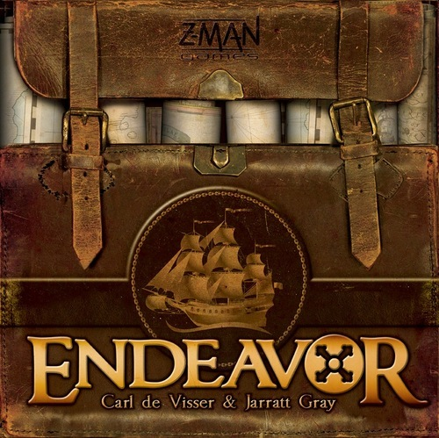
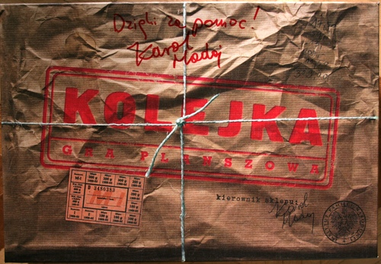

Slide 38


Slide 39
Bringing Games to the Market
Commercial Printer / Supplier Selection
When it is time to request quotes, who do you turn to and how much should you expect to pay? Here are a few variables to consider that you have control over:
  Print run size (this is the single biggest influence of cost per unit)
  Country of Origin (China, USA, Germany)
  Component Quality (Mounted boards vs. Card Stock, Linen finish box vs. plain, triple-core laminated board vs. single, plastic vs. paper, coated vs. uncoated cards, single color vs. 4 color rulebook, translucent dice vs. standard opaque)
  Component Quantity (How many dice and how many pawns or blocks do you really need? How many cards must be in the game?)

Slide 40
Bringing Games to the Market
Commercial Printer / Supplier Selection
Here are a few additional variables to consider that you may not have control over:
  Freight costs
  Production and shipping timelines
  Current costs of raw materials (which fluctuate)
  Supplier’s stock of preferred items (such as dice, etc.)
  Commercial Press Time / Scheduling

Slide 41
Bringing Games to the Market
Commercial Printer / Supplier Selection
Remember, request quotes in multiple quantities
Don’t count out domestic printers. Consider these points regarding “Made in the USA”:
  If your game is “Made in the USA”, you can add that statement to the box, which in my experience has resulted in good PR with some customers.
  Freight costs are significantly reduced
  Time to receive completed products is greatly reduced (no slow boat from overseas)
  Costs are generally higher per unit, but these may very well even out due to freight costs from foreign manufacturers.
  Communication barriers are generally not a factor with USA-based printers.
  Problems with a printed component / proof are harder to deal with when working with overseas printers and you have recourse if there is a problem that cannot be resolved (i.e. a lawsuit). You cannot sue Chinese printers.

Slide 42
Bringing Games to the Market
Setting MSRP
Pricing your game is one of the most important decisions you’ll make. The price is a huge factor for most buyers. Consider these tips on setting an appropriate MSRP:
  Tip 1: Component cost x3 is a good starting point and sets the “distributor price” which is typically 60% off MSRP. Calculate MSRP from there. Example: Components = $5. Distributor Price = $15. MSRP = $15/.4 = $37.5. Or use: Component cost * 7.5 = MSRP.
  Tip 2: Do not price yourself out of distribution. Remember, distributors take 60% of MSRP and receive free shipping to their warehouses.
  Tip 3: Ensure you account for every component, every plastic bag, even the shrink-wrapping in determining your game’s cost. Every penny matters. Reduce costs if you can.
  Tip 4: Test your game’s price with gamers and distributors. Do they perceive value in your product?

Slide 43
Bringing Games to the Market
Funding a Print Run
Crowd-funding is covered in detail in a separate seminar at GTS. I highly recommend attending this topic.
Quick tips on funding:
  Tip 1: Reduce or eliminate your financial risk related to printing by raising the money using crowd-funding (Kickstarter, Indie-go-go).
  Tip 2: Do not use personal credit cards for any reason to fund a print run.
  Tip 3: Ensure the goal you set for any crowd-funding campaign covers the estimated print run cost, freight for receiving the product, and shipping for those who back it. Also account for fees associated with the host and processor (KS takes 5%, Amazon takes another 3-5%)
  Tip 4: An active crowd-funding campaign can provide incredible exposure; use this to your advantage and encourage everyone who supports your campaign to share the project with their friends.

Slide 44
Bringing Games to the Market
Production and Kitting
“All in one” printers specialize in kitting games for you as part of what you pay. This can save you time, but comes with a cost. Know the “assembly” costs up front, before signing a production contract.
Proofing is very important. Do not accept digital proofs of printed products. Ensure you proof one full copy of everything- as a hard copy proof. This will more closely match final colors.
If kitting your own games, try to avoid shrink-wrapping the final games yourself. Shrink-wrapping without professional equipment is time-consuming and mind-numbing. Hire a local print shop to shrink-wrap your games. Rates should be anywhere from $.40-$.60 / game.
If kitting your own games, set up an assembly-line style group of tables, invite your friends, and only offer beer once kitting is complete.

Slide 45
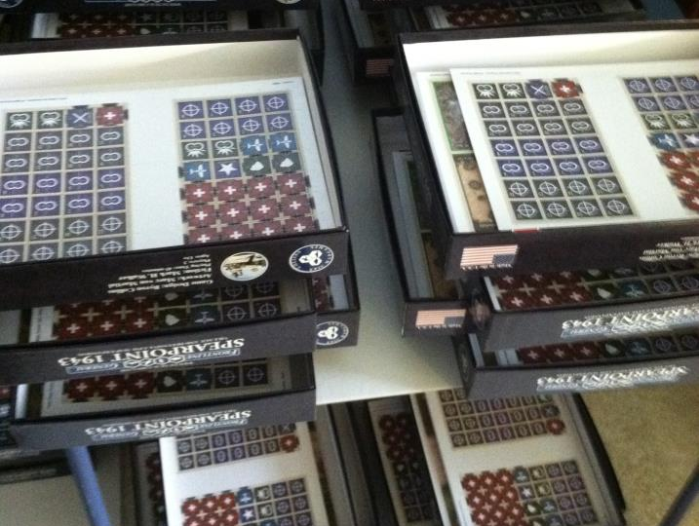
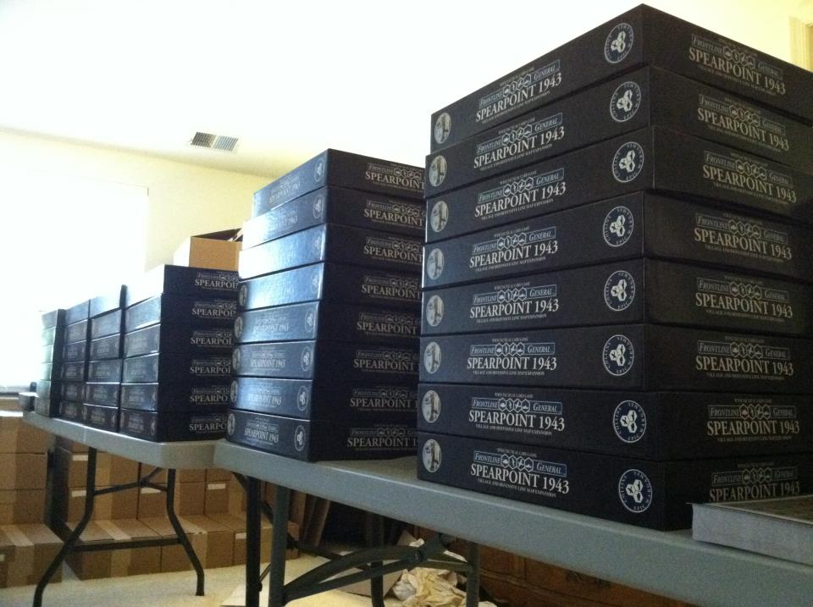
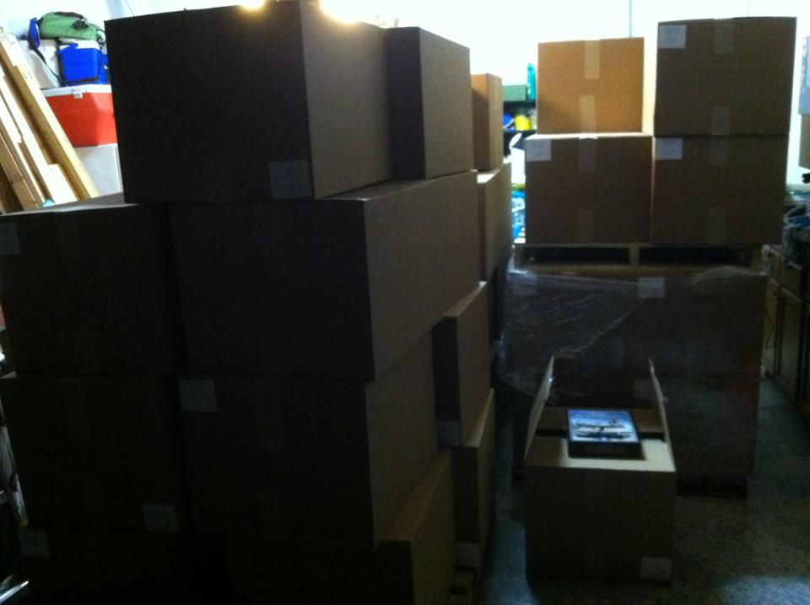
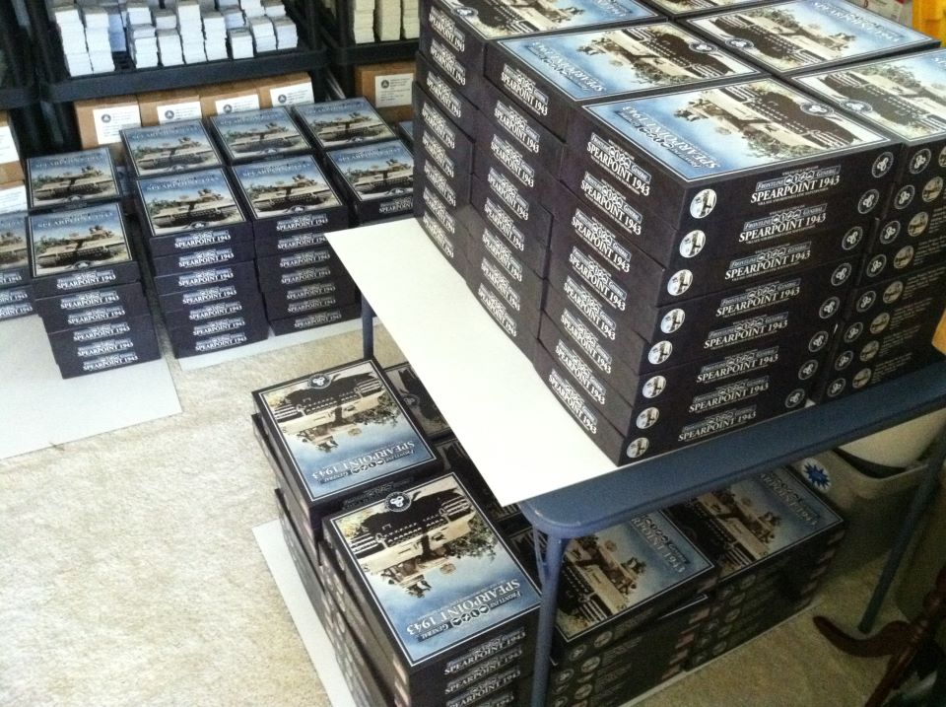

Slide 46
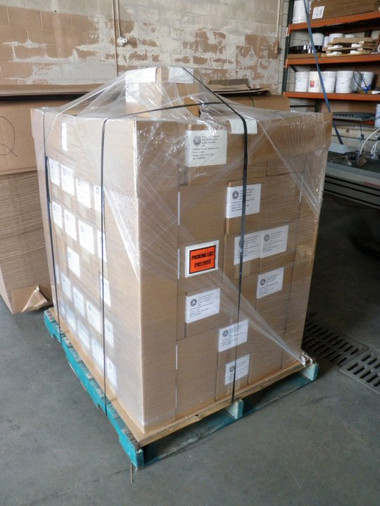
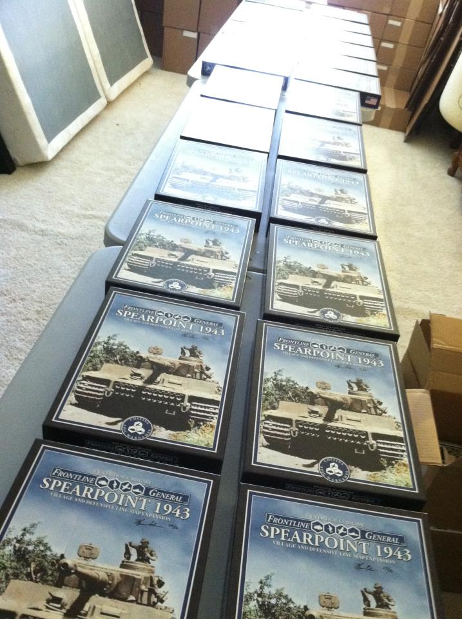

Slide 47
Bringing Games to the Market
Supporting Your Games
Do you have a support structure in place for pre- and post-sale questions? How will you handle missing components? How can gamers get in touch with you directly?
  Tip 1: Include a business card with each game that lists your website, e-mail, and phone number.
  Tip 2: Include website information on the box as a printed link and QR code.
  Tip 3: Don’t create a set of forums on your own website. Sites like BGG already have a community of gamers. Support your games where gamers already spend time.
  Tip 4: Create video tutorials on how to play each game you publish. Some gamers are more visual learners. Pointing them to a video can eliminate lengthy e-mail threads with repeating questions.
  Tip 5: Handle problems quickly and directly.

Slide 48
Bringing Games to the Market
Publisher
Artists
Playtesters
Designers
Distributors
Retailers
Customers
Printers & Suppliers
Editors & Developers
Building Relationships
You will only succeed in the long term if you continuously build your business relationships.

Slide 49

Questions?
Byron Collins
Collins Epic Wargames, LLC
(757) 636-7121
admin@collinsepicwargames.com
Twitter @CEWargames
www.facebook.com/collins.epic.wargames
www.collinsepicwargames.com

